Slide 1



Sr isotopes and hydrological balances in marginal basins
Vanni Aloisi - IPGP
Universidad de Salamanca
25th-29th November 2019
Short Course 1 – Modern and Ancient Oceans

Slide 2
Saline Giant
A thick and extensive salt deposit, produced by the evaporation of a large hypersaline sea.
A Dictiorary of Earth Sciences, Oxford University Press

Slide 3
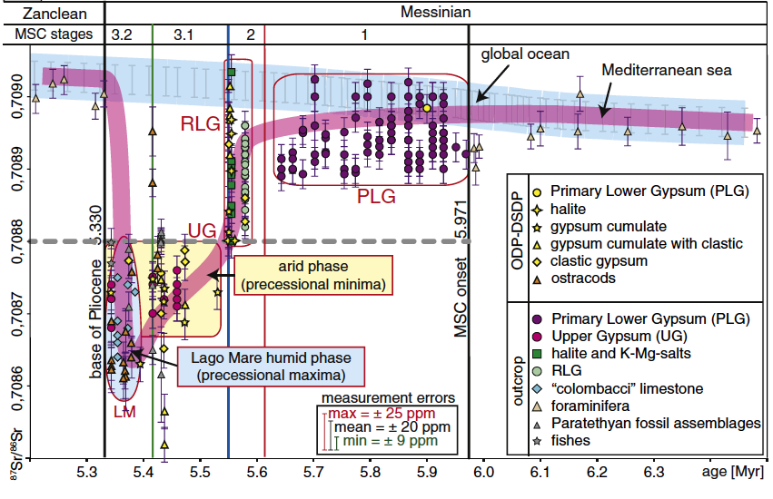
MSC Sr-isotope record
Roveri et al. (2014)

Slide 4

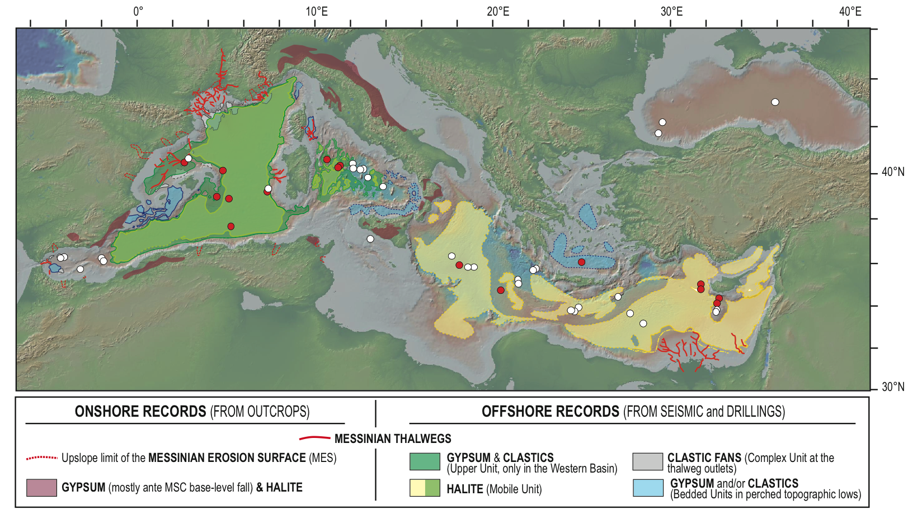
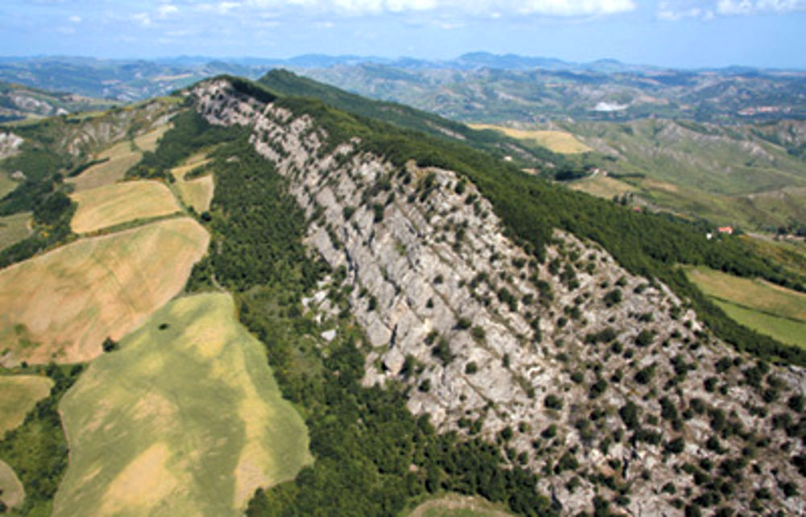
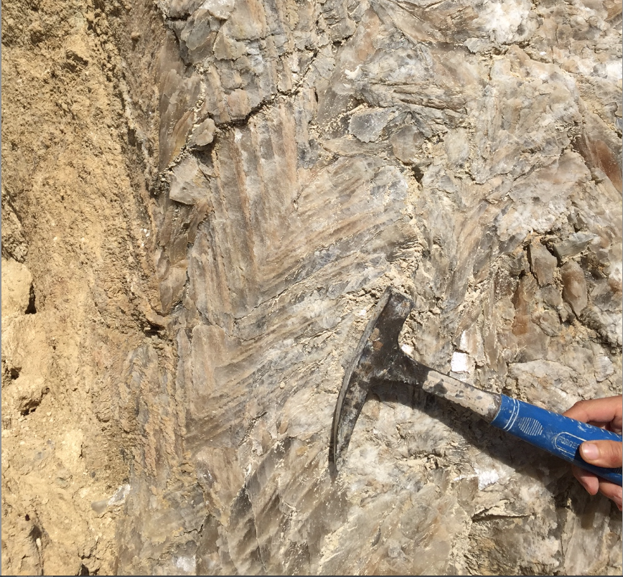
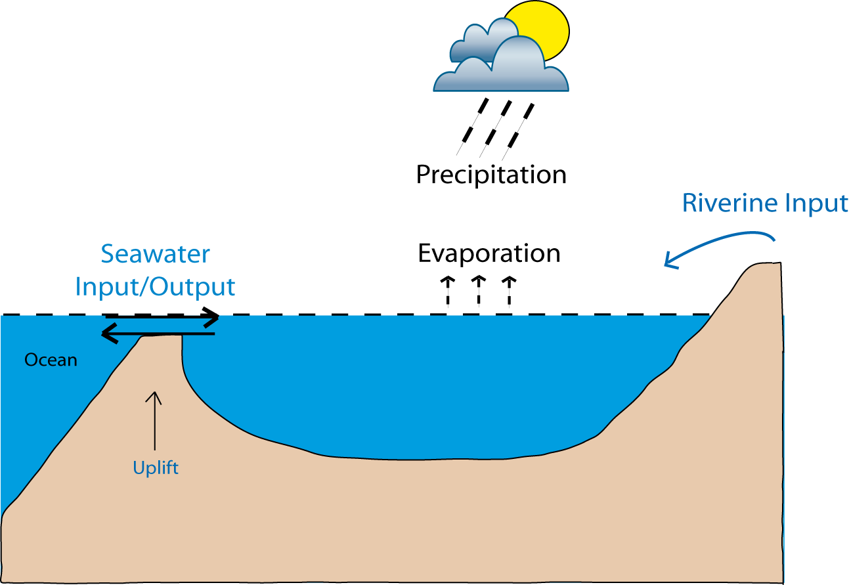
Hydrology of Messisnian margianl basins (ESR 6)
Piemont
Vena del Gesso
Sorbas, Nijar
Caltanissetta
Pissouri
Crete
isotopes
CaSO₄.2H₂O
toit des évaporites
precipitation
Isotopes
de l’eau
Age : Messinien (5.9 – 5.33 Ma)
Echange Altantique-Med.
1M km³ sulfates, halite..
40 ans de recherches
+ 1800 publications
Quoi de neuf ?
CLIMATE
rivers
exchange
evaporation
EVAPORITES (3km)
Marginal basin
Vena de gesso: gypsum-marl cycles
Selenite gypsum
Hydrological cycle
Notes:
Le premier est l’étude du cycle hydrologique dans les bassins marginaux de mediterranée...
Qui étaient subsidiaires au bassin profond au Messinien et qui ont éyés exhumés depuis et se trouvent à l’affleurement.
Ces bassins marginaux contiennent des alternances cycliques gypse-marne.
Das deux bassins: tertiaire du piemont et caltanissetta (Sicile) j’entreprend une étude de la compsoition isotopique de l’oxygène et de l’hydrogène de l’eau de cristallisation du gypse
Le but est de tracer le cycle hydrologique car il nous donn edes infos importantes sur le climat Mediterraneen.

Slide 5
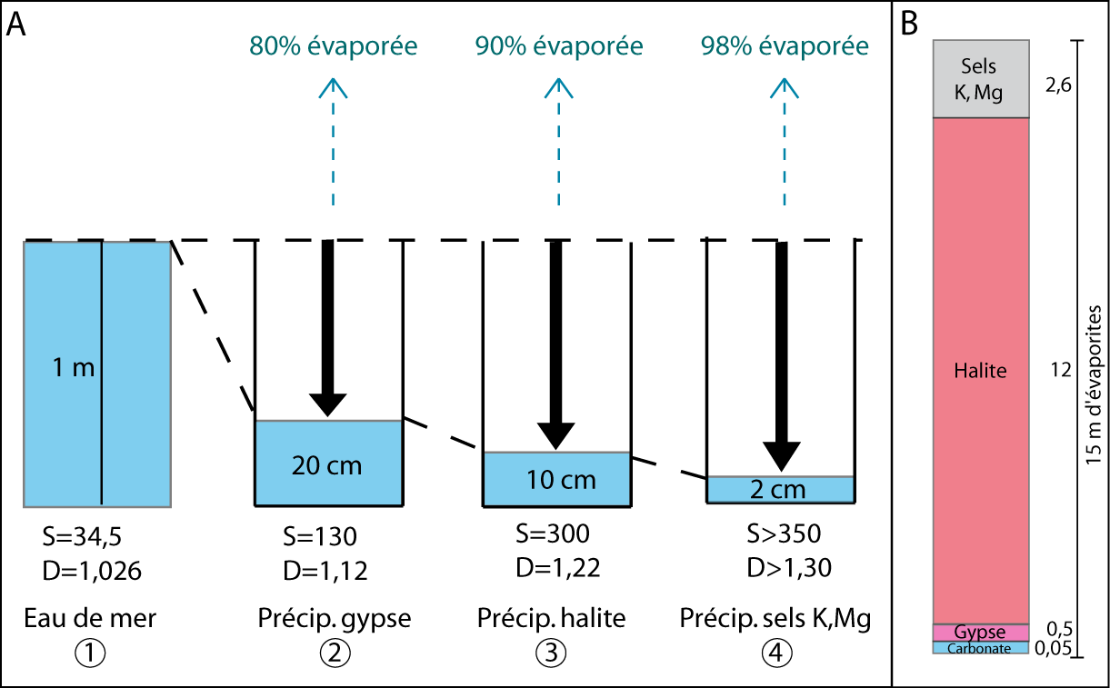
The classical evaporitic sequence: a question of salinity
evaporated
evaporated
evaporated
of evaporites
Seawater
Gypsum ppt
Halite ppt
K, Mg salts
1000 m water column
Rouchy et Blanc-Valleron, 2006

Slide 6
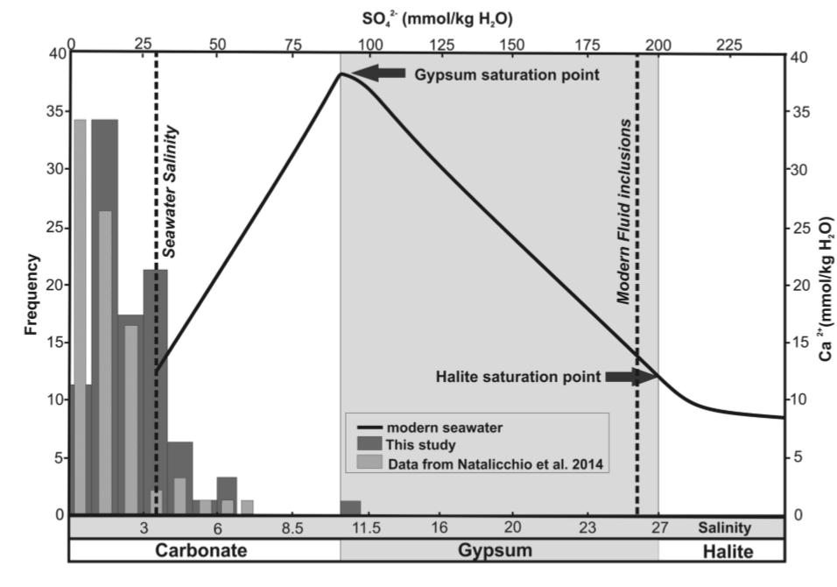
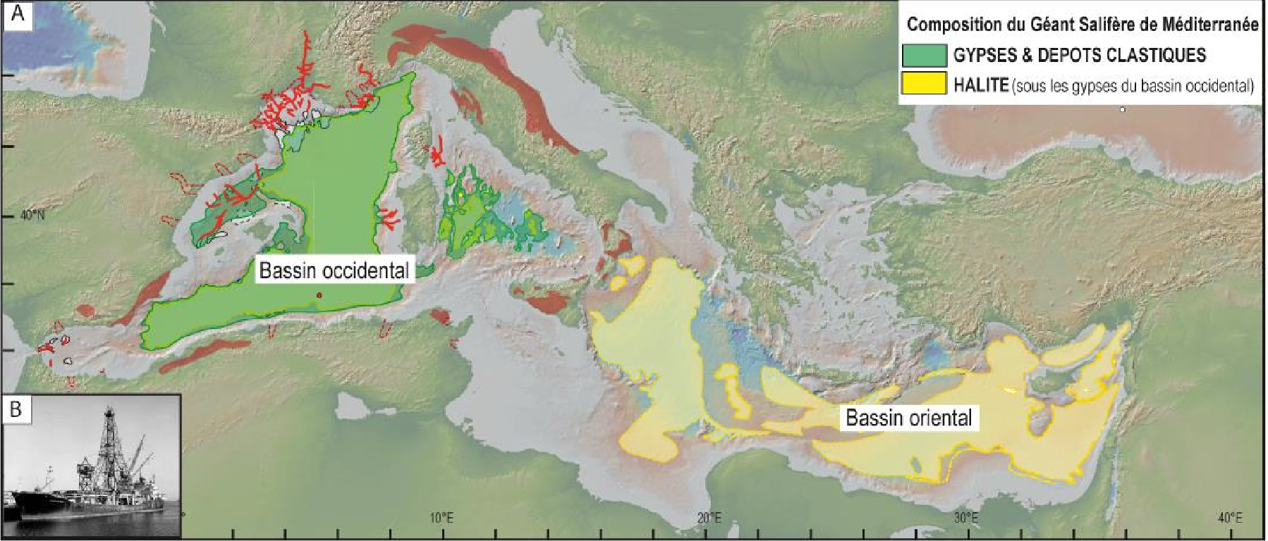
“Low salinity” Primary Lower Gypsum : fluid inclusion data
Piedmont
Calabria
Costanzo et al 2019

Slide 7
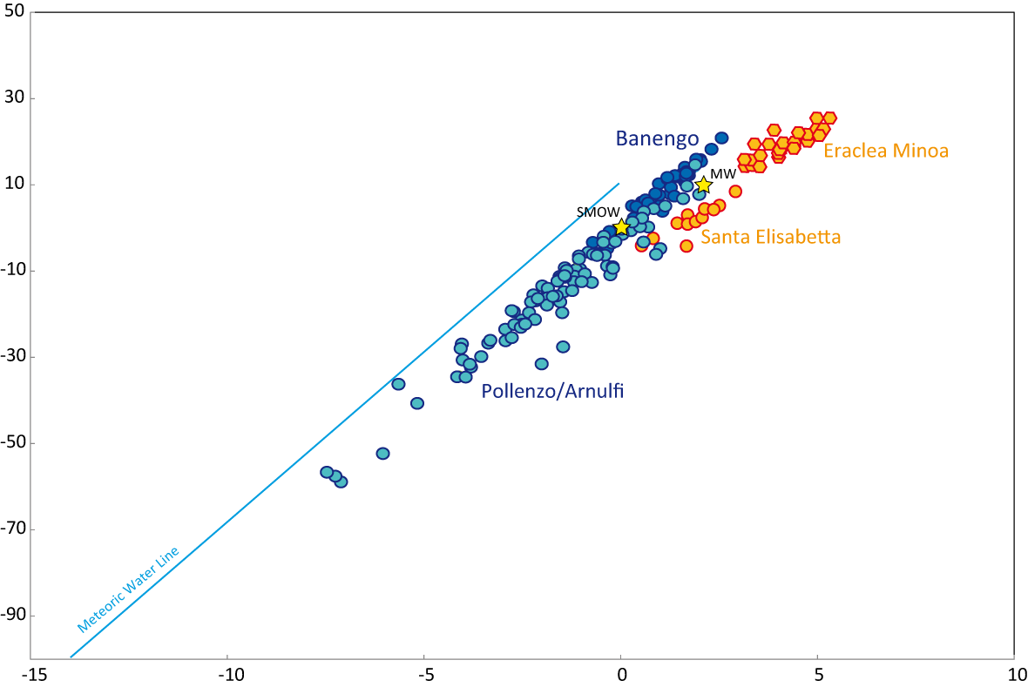
Dilution with continental waters versus evaporation
δD (‰ SMOW)
evaporation
Modern
salina
Caltanissetta
Piemonte
dilution with continental H₂O
δ¹⁸O (‰ SMOW)
Notes:
1-Tous nos gypses sont plus légers que ceux dans les salines
2-forte pente Piedmont
Regression coefficient for the slopes: r²=0,98
Typical slope/Basin

Slide 8
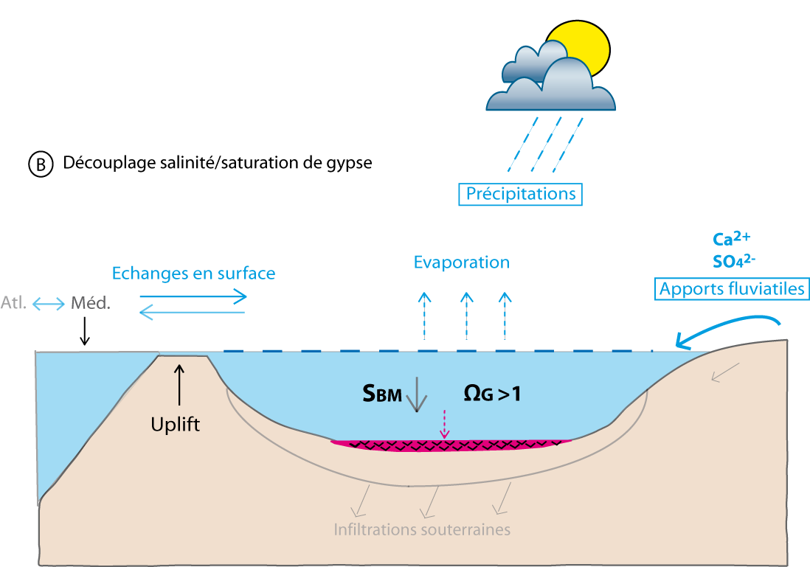
Découplage salinité/concentration de calcium ?
Hypothèse pour expliquer la faible salinité dans les bassins marginaux lors du dépôt des gypses :
Conclusions

Slide 9
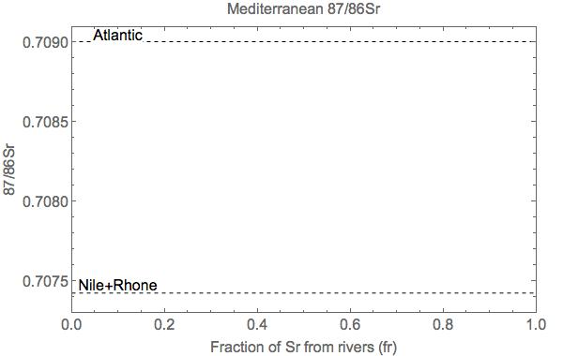

Excercise 1
Simple Sr-isotope mass balance for the Mediterranean
${}_{}^{87/86}{{Sr}_{Med}=f_{Atl}^{Sr}∙ {}_{}^{87/86}{{Sr}_{Atl}} +f_{R}^{Sr}∙}$ ${}_{}^{87/86}{{Sr}_{R}}$
Equations:
$$f_{Atl}^{Sr} +f_{R}^{Sr}=1$$

Slide 10
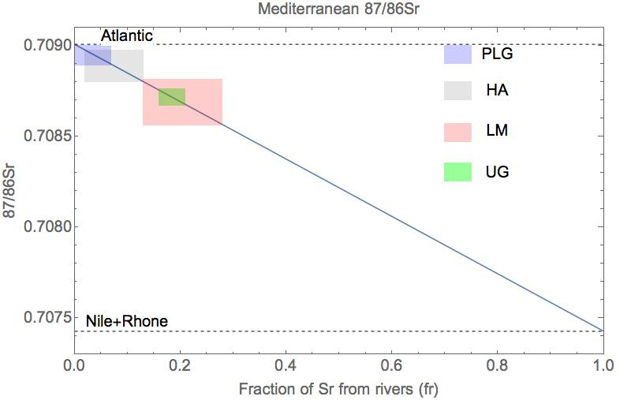
Excercise 1
Simple Sr-isotope mass balance for the Mediterranean

Slide 11

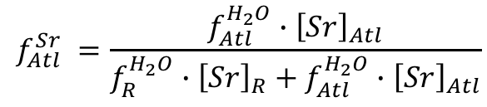
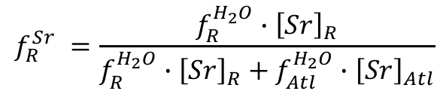
Excercise 2
Simple Sr-isotope mass balance for the Mediterranean
using water fractions
${}_{}^{87/86}{{Sr}_{Med}=f_{Atl}^{Sr}∙ {}_{}^{87/86}{{Sr}_{Atl}} +f_{R}^{Sr}∙}$ ${}_{}^{87/86}{{Sr}_{R}}$
$$f_{Atl}^{Sr} +f_{R}^{Sr}=1$$
Equations:
$$f_{Atl}^{Sr} =\frac{f_{Atl}^{H_{2}O}∙{\left[Sr\right]}_{Atl}}{f_{R}^{H_{2}O}∙{\left[Sr\right]}_{R}+f_{Atl}^{H_{2}O}∙{\left[Sr\right]}_{Atl}}$$
$$f_{R}^{Sr} =\frac{f_{R}^{H_{2}O}∙{\left[Sr\right]}_{R}}{f_{R}^{H_{2}O}∙{\left[Sr\right]}_{R}+f_{Atl}^{H_{2}O}∙{\left[Sr\right]}_{Atl}}$$
[Sr]_{Atl} = 90 * 10⁻⁶ mol litre⁻¹
[Sr]_{R} = 1 -> 5 * 10⁻⁶ mol litre⁻¹

Slide 12
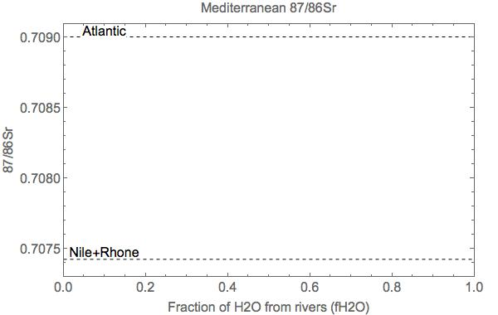
Excercise 2
Simple Sr-isotope mass balance for the Mediterranean
using water fractions

Slide 13
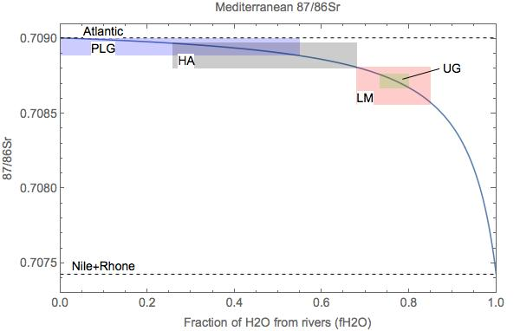
Excercise 2
Simple Sr-isotope mass balance for the Mediterranean
using water fractions

Slide 14
Saline Giant
A thick and extensive salt deposit, produced by the evaporation of a large hypersaline sea.
A Dictiorary of Earth Sciences, Oxford University Press

Slide 15
Excercise 3
Steady state box-model of water, salt, Sr and Sr-isotope
balances in the Mediterranean
Evaporation
Rivers and
precipitation
Sill
exchange
F_{E}
F_{IN}
F_{R}
Atlantic
S = 35 g/litre
g
F_{OUT}
Mediterranean S = ? g/litre
F_{E} > F_{R}: evaporative basin
F_{E} < F_{R}: dilution basin
Additional info:
F_{X}: water fluxes in m³/s
g: ex. coeff in m³/s per unit of sal. diff.
assume steady state

Slide 16

Evaporative marginal basin (F_{E} > F_{R}) : water and salt balance equations
Water volume balance:
F_{IN} + F_{R} = F_{E} + F_{OUT}
Salt mass balance (div V_{MED}):
$$F_{IN}∙S_{ATL}=F_{OUT}∙S_{MED}$$
Density-driven
outgoing water flux:
F_{E}
F_{R}
F_{IN}
Atl
g
Find analytical solution for S_{med} with
Mathematica Solve function
F_{OUT}
Med

Slide 17
Evaporative marginal basin (F_{E} > F_{R}) :
Sr and Sr-isotope balance equations
Sr (div V_{MED}):
$${\left[Sr\right]}_{Atl}∙F_{IN} +{\left[Sr\right]}_{R}∙F_{R}={\left[Sr\right]}_{Med}∙F_{OUT}$$
Sr-isotopes (div. [Sr]_{MED}*V_{MED}):
$${{{}_{}^{87/86}{Sr}}_{Atl}∙\left[Sr\right]}_{Atl}∙F_{IN}+{{}_{}^{87/86}{Sr}}_{R}∙{\left[Sr\right]}_{R}∙F_{R}={{{}_{}^{87/86}{Sr}}_{Med}∙\left[Sr\right]}_{Med}∙F_{OUT}$$
Sr_{IN}
Sr_{R}
Atl
g
Find analytical solution for [Sr]_{med} and
^{87/86}Sr_{med} with Mathematica Solve function
Sr_{OUT}
Med

Slide 18
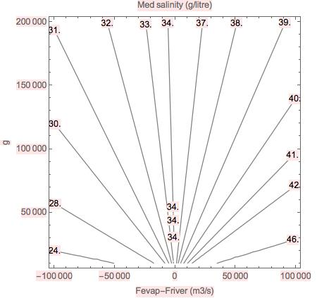
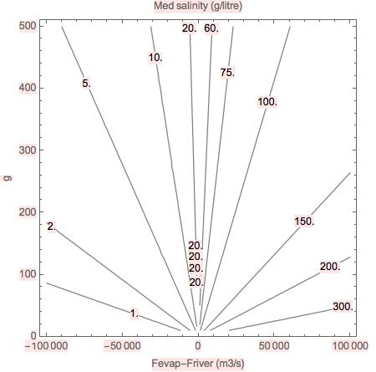
Freshwater deficit and restriction control salinity of Mediterranean basin
Salinity (g/litre) in
modern Mediterranean)
Salinity (g/litre) in
restricted mediterranean
Modern
Med
gypsum
F_{E} < F_{R}
dilution
basin
F_{E} > F_{R}
evaporative
basin
halite
Freshwater deficit F_{E} - F_{R} (m³/yr)
Freshwater deficit F_{E} - F_{R} (m³/yr)
Solution independent of basin volume

Slide 19
Excercise 4
Non-steady state box-model of water, salt, Sr and Sr-isotope
balances in the Mediterranean
Evaporation
Rivers and
precipitation
Sill
exchange
F_{E}
F_{IN}
F_{R}
Atlantic
S = 35 g/litre
g
F_{OUT}
Mediterranean S = ? g/litre
F_{E} > F_{R}: evaporative basin
F_{E} < F_{R}: dilution basin
Additional info:
F_{X}: water fluxes in m³/s
g: ex. coeff in m³/s per unit of sal. diff.
assume steady state

